Slide 1


Slide 2
R26-SE-013
SLIIT / SOFTWARE ENGINEERING / FINAL VIVA
PP2 COMMENTS & RESPONSE
Panel feedback → research response
Four individual research components
MEMBER
PP2 FEEDBACK
ACTION / EVIDENCE FROM THESIS
EVIDENCE BOUNDARY
IT21129544
Proper evaluation should be done.
Held-out ViT test (90.11%); detector validation
segmentation comparison.
Clinical-review portal verified with limited sample images.
Smart Diagnosis
IT22194558
Automate input intake instead of user-entry; conduct proper evaluation.
Automated anomaly trigger and weather/THI retrieval
95.80% RF internal test result.
Daily observations still manually entered.
Wellness Triage
IT22221414
Validate component accuracy using future data; evaluate properly.
Rolling-origin back-test on held-out months (FMD 2022–23, LSD 2023–24), vs seasonal-average and last-month baselines
PR-AUC gain with 6-month block bootstrap
Veterinary expert review letters.
Back-tested on historical data only
forecasts now stored frozen to be scored prospectively.
Evidence modest
Risk Forecasting
IT22258908
Proper evaluation; PP2 demo used dummy data due to API outage.
Retrospective LSD 7-day spatial ranking (73.85 percentile) and structural direction checks.
Not prospective/live field validation.
Geospatial
A Centralized System for Real-Time Farm Animal Disease Reporting
01 / 07
Notes:
Purpose: explicitly address every recorded PP2 comment for panel SE-P02, matching student IDs to uploaded theses.
Smart Diagnosis: thesis Chapter 6 documents ViT held-out accuracy 90.11%, YOLO validation curves and refined segmentation mIoU 0.4078 (baseline ~0.298); independent clinical review on adrs-clinical-review.me could not be accessed during production.
Wellness: thesis §6.1 documents 99.80% on engineered monitoring dataset and automatic THI; daily yield/weight intake remains manual, so the intake feedback is only partially resolved.
Forecast: thesis §6.1 uses 2024 holdout and year-separated validation. This must not be described as observed prospective future-date forecasting.
Geospatial: thesis §6.1 documents held-out ranking conditional on a 25 km envelope, and directional structural verification. User-facing fourteen-day forecast is illustrative.

Slide 3
R26-SE-013
SLIIT / SOFTWARE ENGINEERING / FINAL VIVA
OVERALL PROBLEM & SOLUTION
Why ADRS - And what is different
A traceable veterinary decision-support workflow for Sri Lankan livestock surveillance.
01
02
THE PROBLEM
Wellness triage
Smart diagnosis
Fragmented records.
Delayed action.
Incomplete context.
Daily trends + 2D body condition + thermal context.
Image localisation, candidate class and lesion mask.
03
04
No affordable, shared evidence chain currently moves from farmer signal to clinical action, mapped trajectory, and district response.
Farm-level symptoms, images and case reports are interpreted separately from spatial and climatic trends.
District risk
Geospatial analysis
Monthly FMD / LSD outbreak-risk forecasts per district, from climate, season and outbreak history.
Each forecast comes with an uncertainty range and is approved by a veterinarian before it is issued.
Confirmed-case mapping and historical spatial ranking.
DESIGN EXCELLENCE • One platform, four evidence streams, veterinarian in the loop
A Centralized System for Real-Time Farm Animal Disease Reporting
02 / 07
Notes:
The official project title is A Centralized System for Real-Time Farm Animal Disease Reporting.
Problem framing synthesized from all four theses: fragmented reporting and insufficient timely, spatial and physiologic context.
Design excellence is modular decision support and evidence traceability, not a claim that all subcomponents have prospective clinical field validation or autonomous diagnosis.
Architecture draws from Smart Diagnosis Figure 1 and each component thesis introduction. Human veterinary review remains the decision boundary.

Slide 4
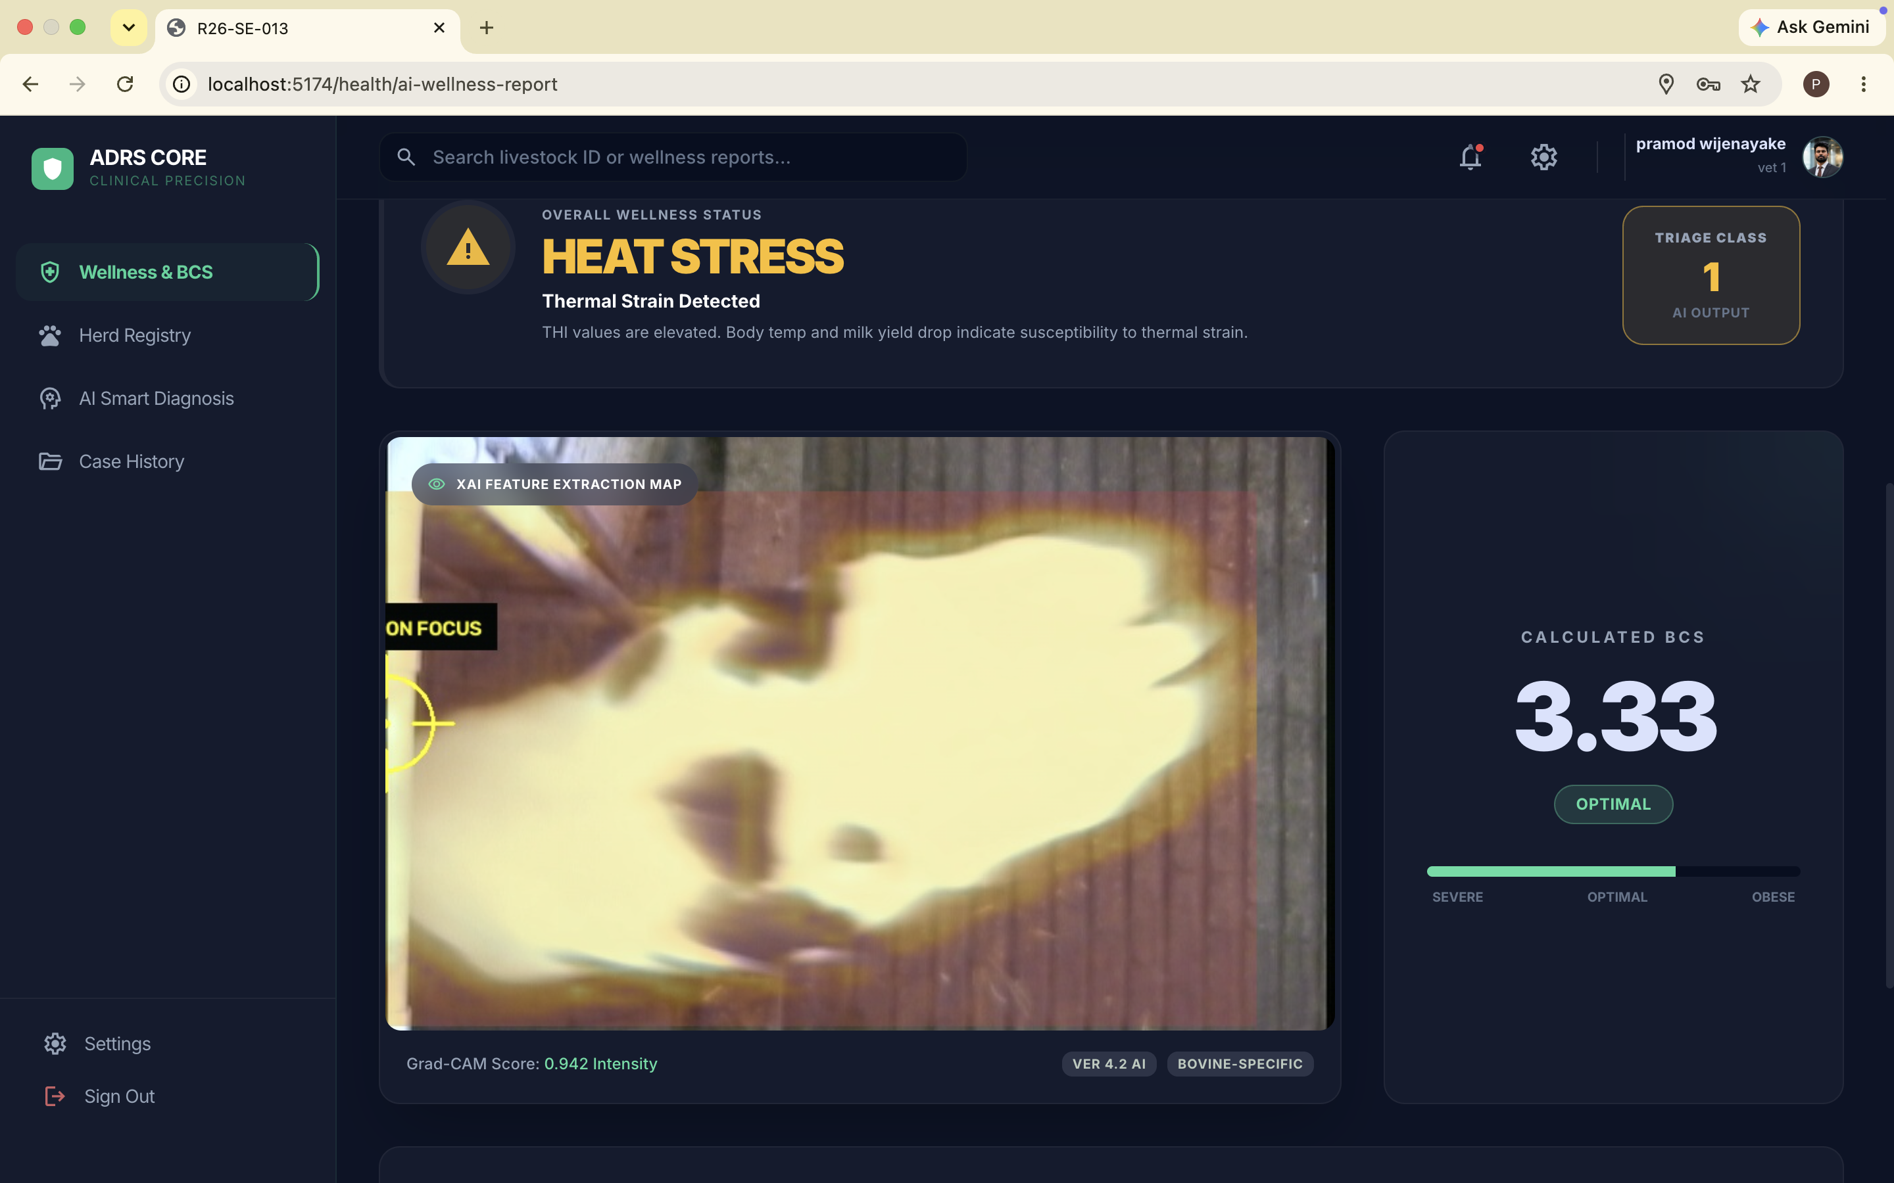
R26-SE-013
SLIIT / SOFTWARE ENGINEERING / FINAL VIVA
INDIVIDUAL COMPONENT · 01
Persistent Health Anomaly & BCS Triage
W.M.P.J. Wijenayake • IT22194558
AUTOMATED TRIGGER
Daily health trends
Random Forest monitoring flags deviations from milk-yield and body-weight logs.
CONTEXTUAL ASSESSMENT
2D BCS + 7-day signals
YOLOv8s → CNN BCS; LSTM late fusion incorporates history, genetics and thermal stress.
95.80%
ACTUAL WELLNESS TRIAGE RESULT
Persistent-monitoring test accuracy on engineered scenarios.
Research contribution · Low-cost, on-demand triage with explainable 2D BCS and thermal context
A Centralized System for Real-Time Farm Animal Disease Reporting
03 / 07
Notes:
Member: W.M.P.J. Wijenayake (IT22194558).
Slide explains two-phase wellness triage: logs are input daily; an anomaly can automatically initiate deeper analysis or user manually requests it. 7-day logs, THI, static breed context and image-based BCS are fused into Healthy, Heat Stress or Unhealthy.
Thesis §6.1: 99.80% Random Forest accuracy on mathematically engineered breed baselines and 3-day physiological trend scenarios. 20-cow controlled demonstration reached 100% for optimized fusion model, but too small and synthetically structured to claim clinical generalization.
PP2 response: alert initiation and weather/THI intake are automated, but daily health data input is still manual. Acknowledge openly.
Visual is actual Figure 4 from uploaded W.M.P.J. Wijenayake thesis.

Slide 5
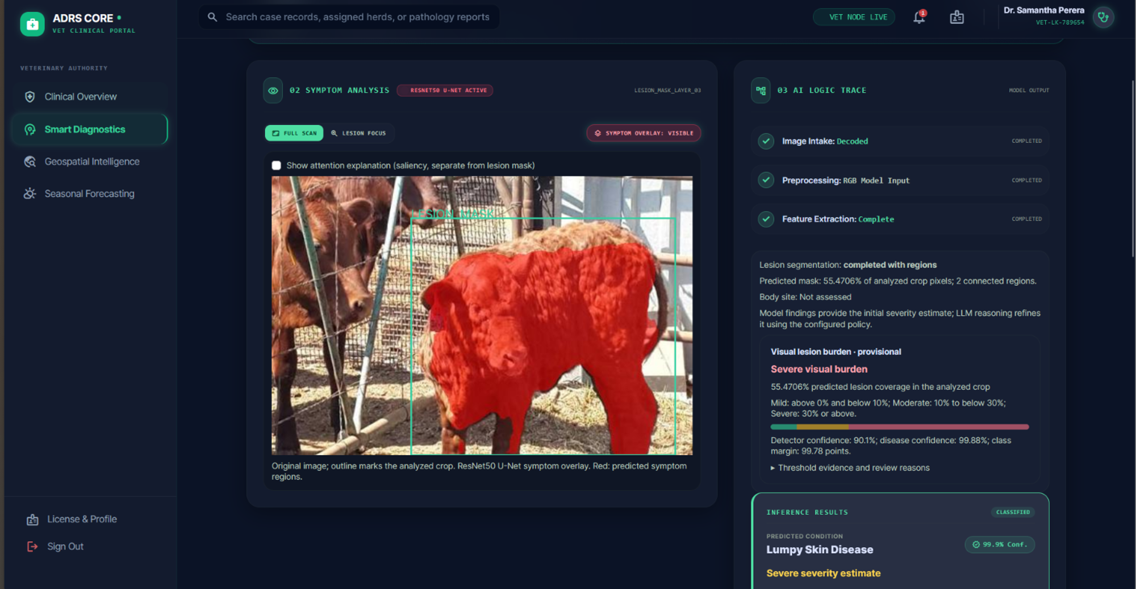
R26-SE-013
SLIIT / SOFTWARE ENGINEERING / FINAL VIVA
INDIVIDUAL COMPONENT · 02
AI Smart Diagnosis — image evidence
A.L.M. Athulathmudali • IT21129544
01
YOLOv8s
Region / disease-related localisation
02
ViT-B/16
Four-class candidate classification
03
ResNet50
Optional lesion-mask segmentation
90.11%
ViT-B/16 held-out test classification accuracy
MODEL OUTPUT FOR A SAMPLE IMAGE
A Centralized System for Real-Time Farm Animal Disease Reporting
04 / 07
Notes:
Member: A.L.M. Athulathmudali IT21129544.
Object detector YOLOv8s identifies bounding boxes; coordinates generate ROI crops; square-pad, resize 224 × 224, ImageNet-normalize; ViT-B/16 predicts four labels; optional ResNet50 backbone with custom mask head outputs lesion mask. Do not call this a full Mask R-CNN.
Thesis Chapter 6: held-out ViT test accuracy 90.11%, YOLO validation mAP50 ~0.81 at epoch86 and refined segmentation mIoU 0.4078 on 100 samples vs 0.298. Class-specific detector metrics and formal calibration not reported.
No independently verifiable results from https://adrs-clinical-review.me/ were available at deck preparation. Replace final UAT status only when signed evaluator data/screenshots are provided.
Source figure: Smart Diagnosis thesis Fig. 5, original embedded image.

Slide 6
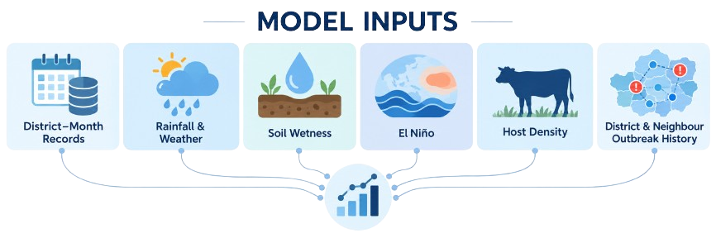
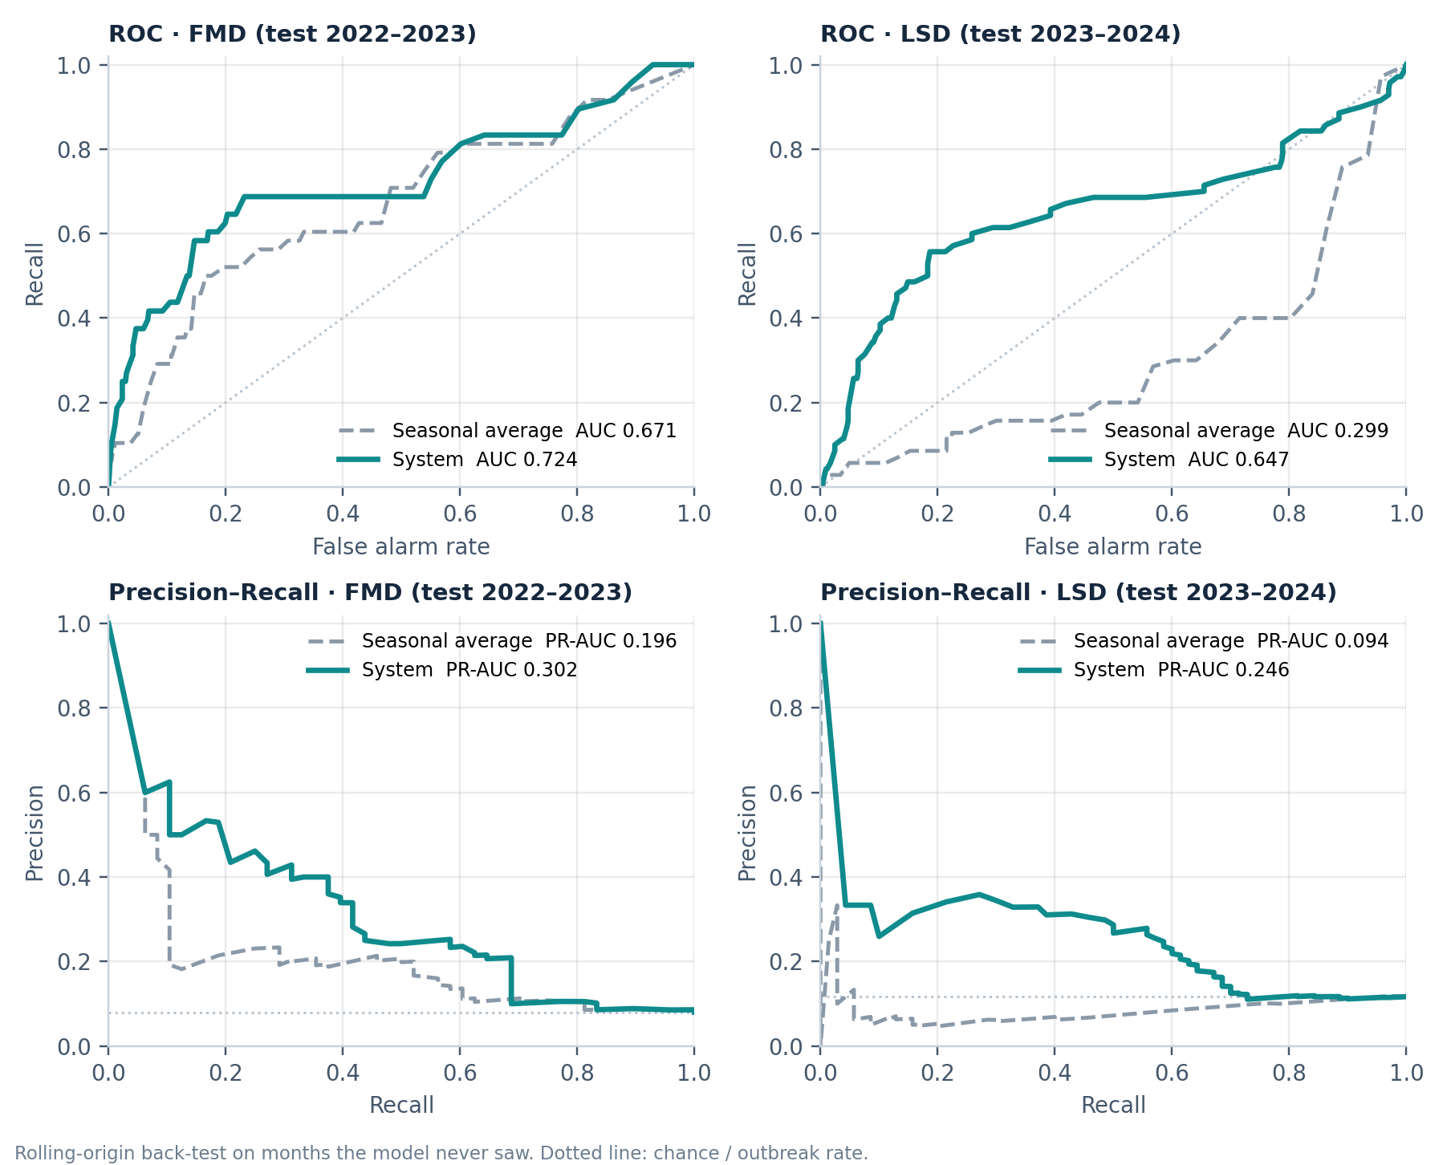
R26-SE-013
SLIIT / SOFTWARE ENGINEERING / FINAL VIVA
INDIVIDUAL COMPONENT · 03
Climate-informed monthly outbreak-risk forecasting
S.S. Kumarasinghe • IT22221414
0.724
0.302
FMD test ROC-AUC · back-test 2022–2023
FMD test PR-AUC · seasonal average 0.196
0.647
0.246
LSD test ROC-AUC · back-test 2023–2024
LSD test PR-AUC · seasonal average 0.094
FMD / LSD ROC and precision-recall curves (back-test, held-out months)
A Centralized System for Real-Time Farm Animal Disease Reporting
05 / 07
Notes:
Member: S.S. Kumarasinghe IT22221414.
FMD 2400 district-month observations 2017-2024. Baseline 30-feature logistic regression production model; 31-feature variant adds previous-month district outbreak and is the reported stronger held-out 2024 result (ROC-AUC 0.8166, PR-AUC 0.6968, recall 67.9% at 0.40 decision threshold). Mean walk-forward ROC-AUC 0.8120 across 2022-2024.
LSD 1500 district-month observations 2020–2024. Platt-calibrated ElasticNet 28 features mean LOYO ROC-AUC 0.6136 and PR-AUC 0.2699.
PP2 response: year-separated holdout evaluates generalization across prior years, but software projections for future dates use historical same-calendar-month proxies. This is NOT validated future-weather based prediction.
Original Figure 6 from forecast thesis.

Slide 7
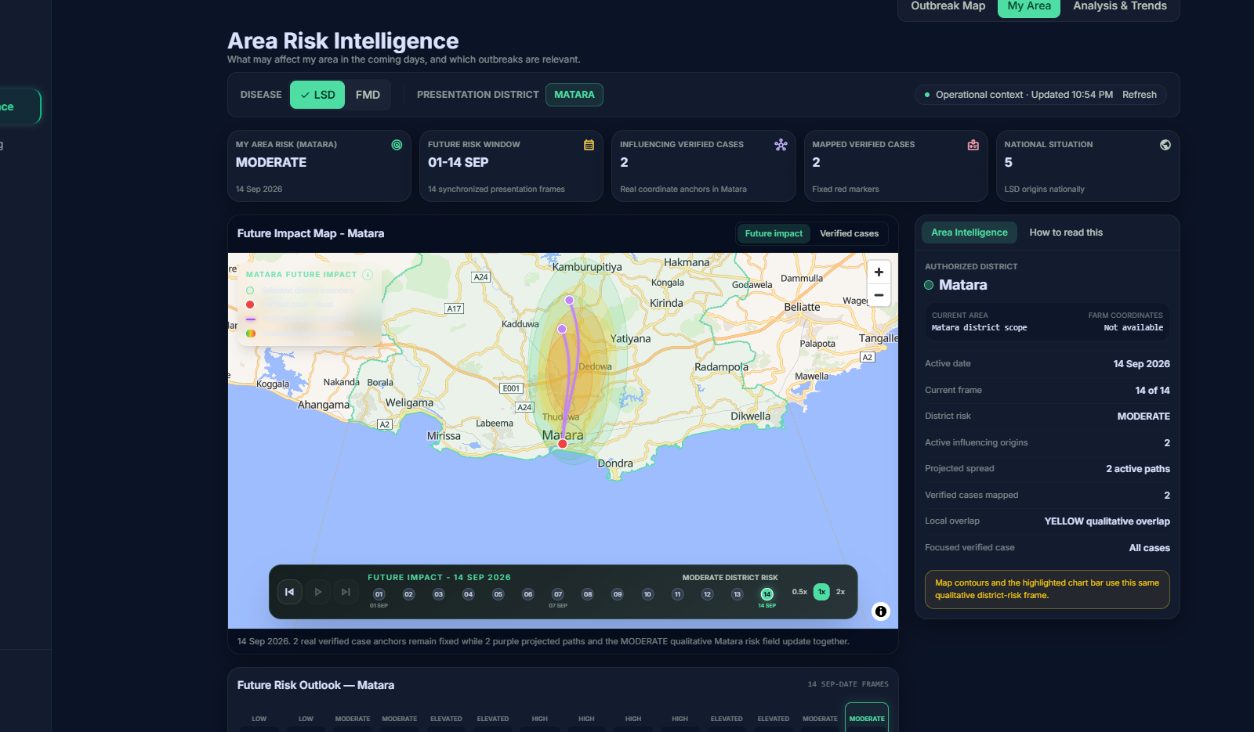
R26-SE-013
SLIIT / SOFTWARE ENGINEERING / FINAL VIVA
INDIVIDUAL COMPONENT · 04
Geospatial clustering & trajectory mapping
G.A. Sandaru • IT22258908
RESEARCH BASELINE
5 km spatial cells
Source-aware historical LSD events are ranked using a frozen exponential distance kernel.
73.85
Held-out area-weighted target percentile; limited to 25 km evaluation scope.
IMPORTANT INTERPRETATION
D1–D7 evaluated retrospectively; 14-day UI is illustrative, not day-wise validated incidence.
ACTUAL MY AREA MAP & OUTLOOK
Supporting evidence · 323 / 588 held-out targets in 25 km scope • zero geometric invariant failures on 560,853 cells
A Centralized System for Real-Time Farm Animal Disease Reporting
06 / 07
Notes:
Member: G.A. Sandaru IT22258908.
LSD: 3089 source records, 2587 conservative entries, 1480 model-eligible candidates; model C0 uses exp(-d/25km) summed over prior eligible sources and ranks approximately 5-km cells. This score is not infection probability.
D1–D7 held-out mean area-weighted percentile 73.85 (95% origin interval 70.51–77.11), conditional on a 25km domain. 323 of 588 targets fell inside the domain; Sri Lankan transfer sample had just one evaluable target.
One technical test validated the geometric direction field over 560853 cells without invariant violations; it does NOT validate actual transmission bearings. Historical apparent spread rate 3.946 km/day nominal, not actual validated infection speed.
The My Area 14-day timeline image is an illustrative UI output and cannot be presented as validated 14-day prediction. Original fig 6.4 from geospatial thesis.

Slide 8
R26-SE-013
SLIIT / SOFTWARE ENGINEERING / FINAL VIVA
CONSOLIDATED RESULTS
Results, expert review & next steps
Research evidence is separated from clinical acceptance and operational deployment.
WELLNESS
SMART DIAGNOSIS
RISK FORECASTING
GEOSPATIAL
95.80%
90.11%
0.724 (FMD) & 0.647 (LSD)
73.85
RF test · engineered trend scenarios
ViT held-out classification test
FMD / LSD ROC-AUC/ back-test on unseen months
LSD held-out area-weighted percentile · 25 km scope
USER REVIEW / ACCEPTANCE
LIMITATIONS → FUTURE WORK
Expert review evidence
Prospective local field tests and independent expert ratings
Class-wise diagnosis metrics, calibration and buffalo validation
A veterinary expert (Dr. T. Karunarathna, Senior Lecturer, University of Peradeniya) reviewed all four components and regarded the project as "A promising contribution to livestock health monitoring". The tools are valuable as supporting information alongside examination, animal history and professional judgement, not as substitutes for a veterinarian.
Score stored forecasts against real outbreaks. Extend verified FMD labels beyond 2023
Operational API resilience and geospatial source verification
A Centralized System for Real-Time Farm Animal Disease Reporting
07 / 07
Notes:
Compare unlike metrics honestly. The wellness result is RF accuracy on mathematically engineered scenarios; the diagnosis 90.11% is held-out classification; FMD 0.8166 is ROC-AUC and not accuracy; the geospatial 73.85 is an area-weighted rank percentile conditional on a 25 km evaluation scope and not predictive accuracy.
Clinical feedback: wellness thesis describes qualitative positive practitioner feedback; source does not include an independently authenticated UAT score that can be shown as a validated acceptance result. The smart-diagnosis review site https://adrs-clinical-review.me/ failed to load via available browsing and DNS during deck creation. Do not invent clinician quotes or ratings.
Limitations/future work directly synthesize uploaded individual theses: synthetic wellness sequences; CV no OOD/calibration, no cross-buffalo split; nowcast future proxy is not validated forecast; geo mostly historical non-local material and 14-day UI illustrative.
Before submission, replace the clinical-review section only after uploading actual review screenshots/export and signed vet UAT documentation.

